Slide 1
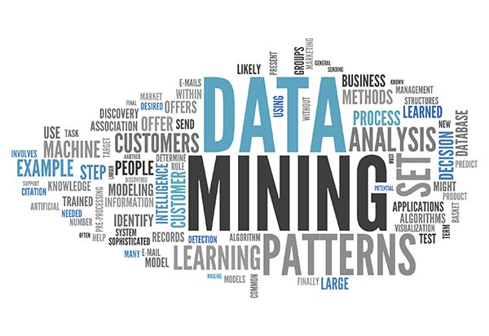
Text Mining
Dr. Liang (Leon) Chen
Picture Source: http://jalk.dvrlists.com/data-mining
Notes:
Hello everyone, welcome to Week 11. So far, we have learned different types of data mining techniques and algorithms, which deal with structured data (numerical and categorical data). How about unstructured and semi-structured data? Can we generate a meaningful pattern, trend, or relationship from those data? The answer is yes. We need to use text mining, which mainly deals with textual data. Look at this diagram, which is an example of text mining. Later, you will know that this is called bag of words.

Slide 2
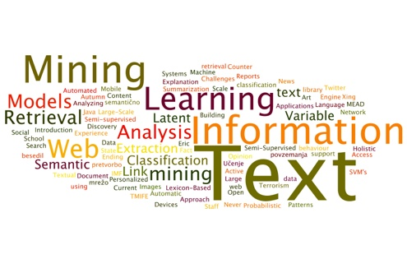
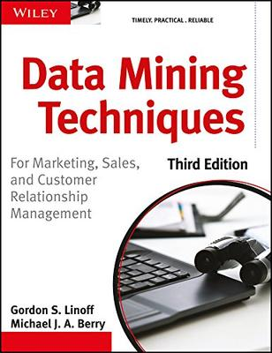
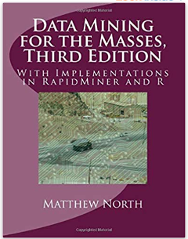
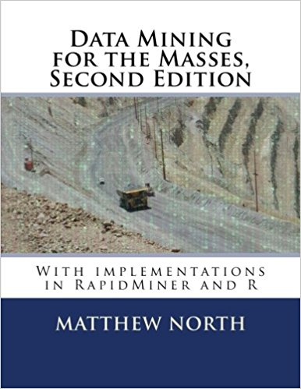
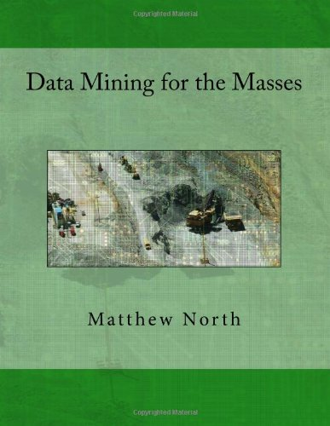
Recommended Readings
Chapter 21, Linoff and Berry
Chapter 12, Matthew A. North

Slide 3
Learning Objectives
Concepts in text mining
Applications of text mining
Process of text mining

Slide 4

Introduction
“Automatic analysis of text to extract information that is useful for particular purposes”
Input
Output
Patterns Connections Trends Profiles
Etc.
Text: natural language, unstructured, semi-structured
Text data mining, text analytics, etc.

Slide 5
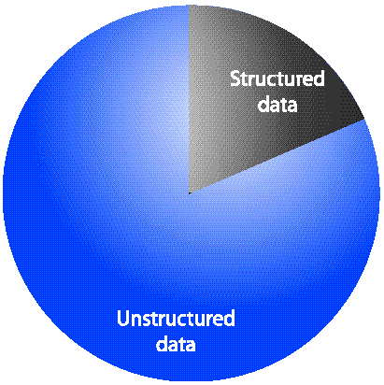
Unstructured Data
Information that either does not have a pre-defined data model or is not organized in a predefined manner.
80-90 percent of all corporate data is in some kind of unstructured form (e.g., text)
Business data:
Call center transcripts
Other CRM
Email, text messages,
Open-ended survey responses
Web pages, blogs
Organizational documents
Regulatory information
Forum, tweets, Facebook messages,
Online reviews
Notes:
Structured data has a specific data model such as ER (entity-relationship) model. Generally, the data in our database is a structured data. As you can see, structured data has a high degree of organization. In contrast, unstructured data is more subjective and is usually text heavy. It does not have a pre-defined data model or is not in a predefined manner. It can't generally be put into a data structure like columns or rows (relational database).
However, 80-90 percent of all corporate data is in some kind of unstructured form (e.g., text).
Unstructured data can be found in documents, presentations, audio, images, videos, messages, and books. Unstructured data can also come from social media sites such as Facebook, LinkedIn, Twitter, Tumblr, Flickr, Yelp, YouTube, and Pinterest. Some examples of unstructured data include business data (e.g., call center transcripts), emails, text messages, email, webpages, government documents, customer reviews that describe how they feel about an experience, etc.
Nowadays, unstructured data could be stored in NoSQL databases such as Bigtable, MangoDB.

Slide 6
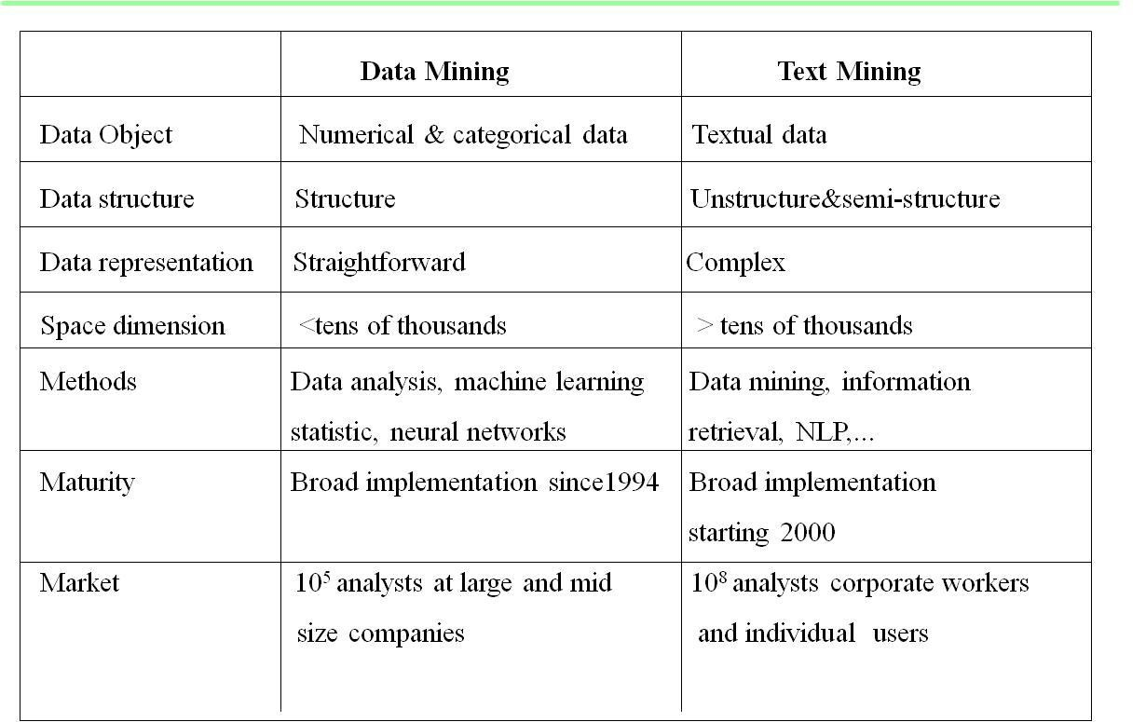
Text Mining and Data Mining
NLP: Natural language processing
Notes:
This table shows you the differences between data mining and text mining.

Slide 7
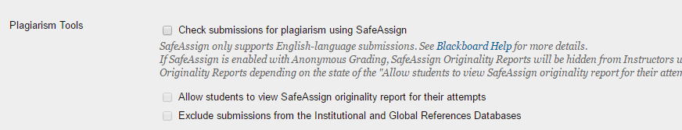
Text Mining Applications
Spell checking and grammar checking (e.g., MS WORD)
Language translation (e.g. Google Translate)
Search engine (e.g. Google, Bing)
Summarizing documents (e.g., stock news)
Spam identification (e.g., Truecaller)
Plagiarism identification (e.g., SafeAssign on BB)
Customer opinion extraction (e.g., sentiment analysis)
Surveillance on terrorisms or public health threats
Etc.

Slide 8
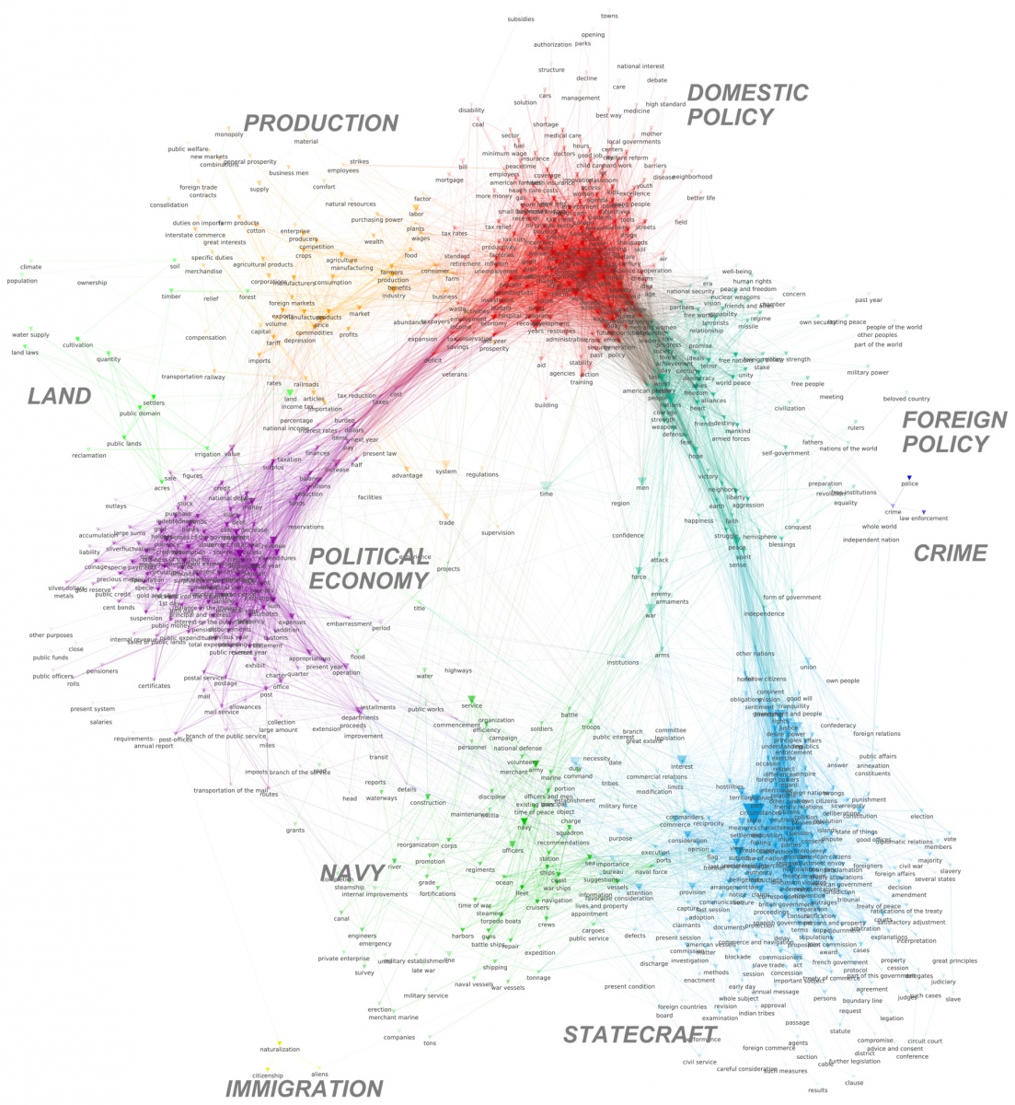
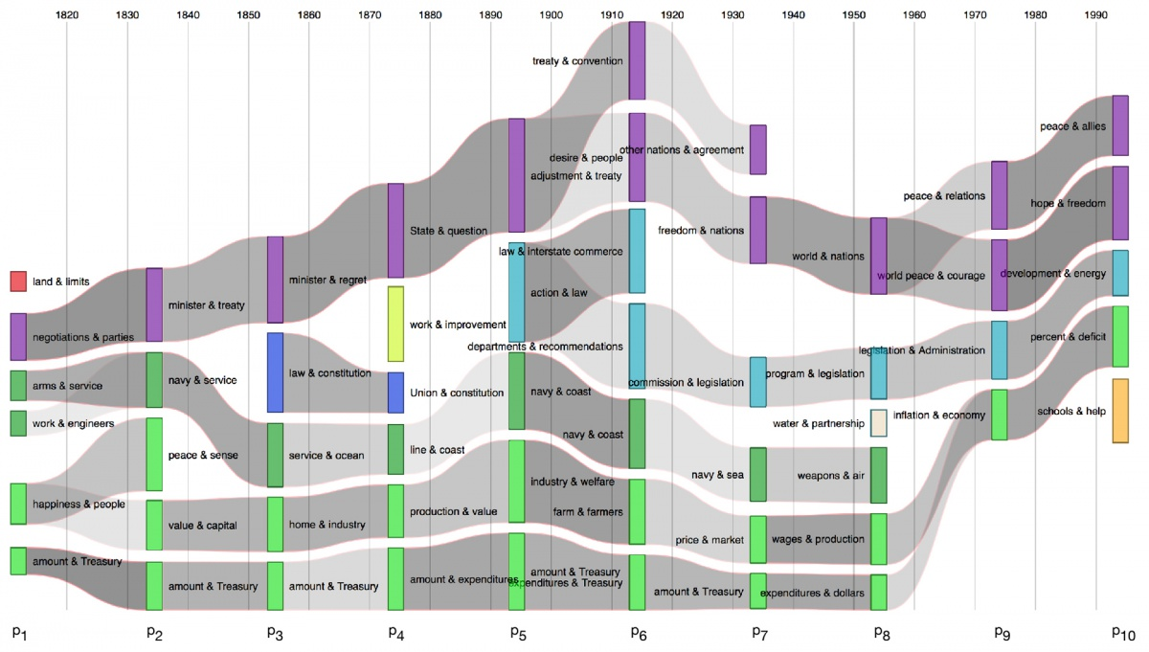
Some Examples of Text Mining
A river network captures the flow of terms across history of US political discourse
Text mining strikes gold in political discourse

Slide 9
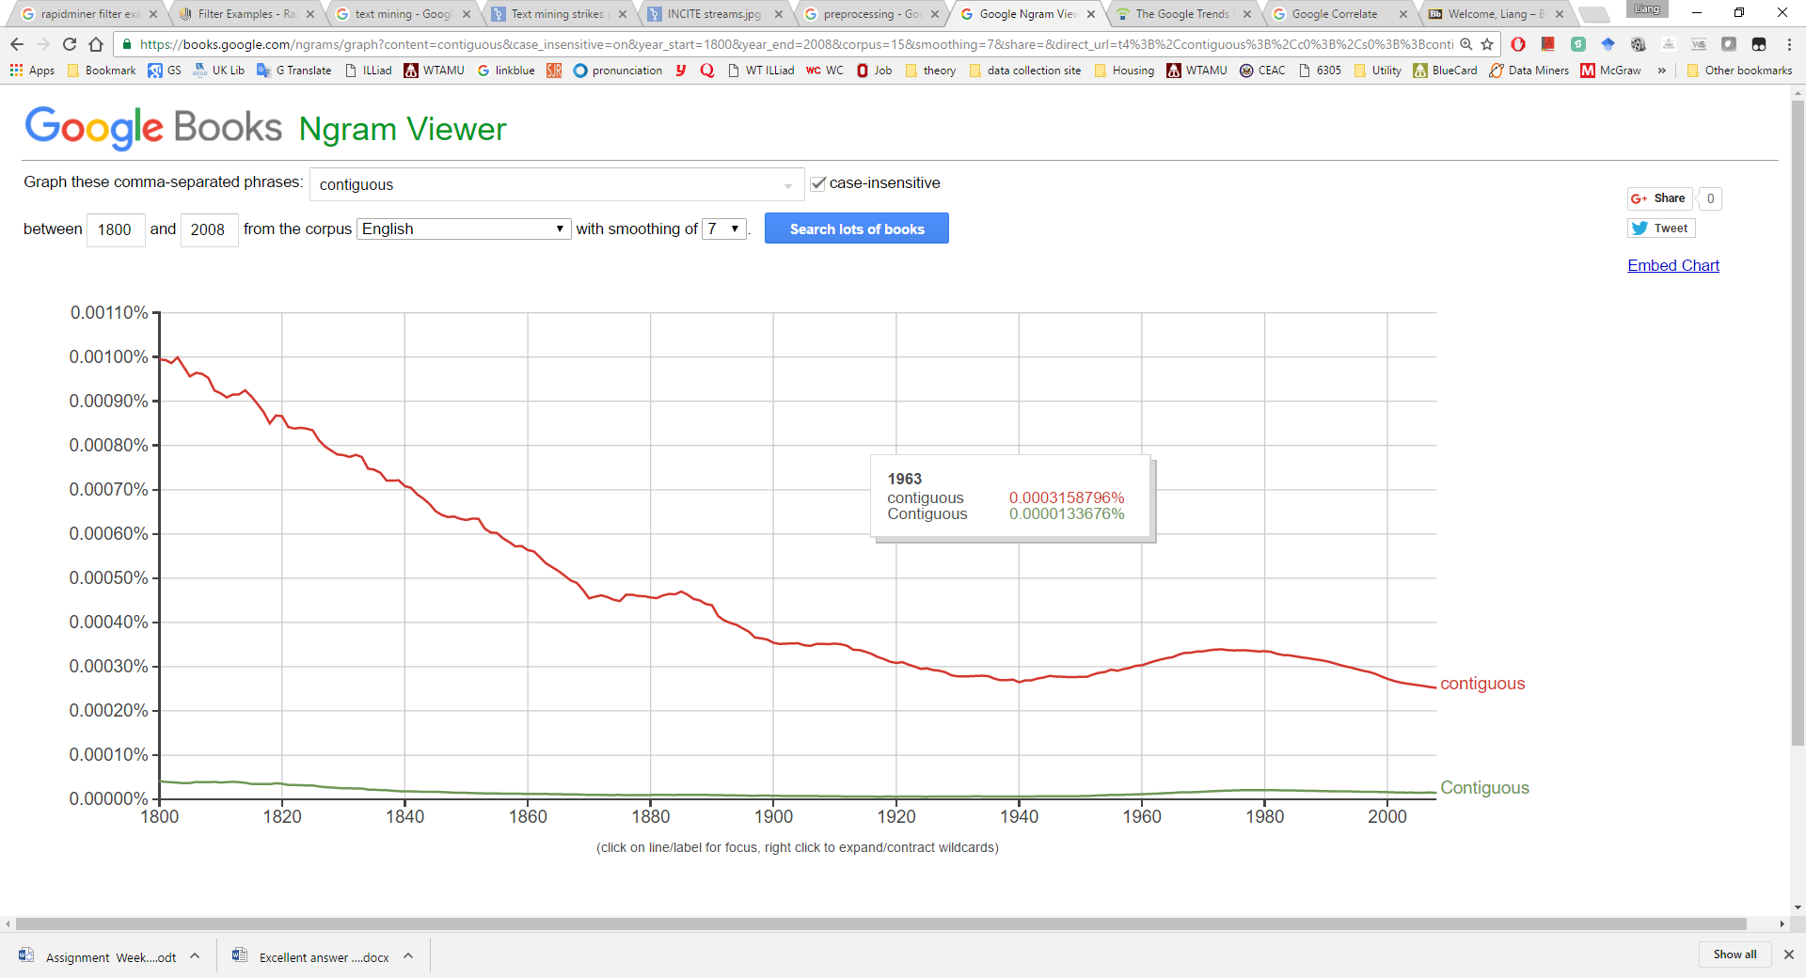
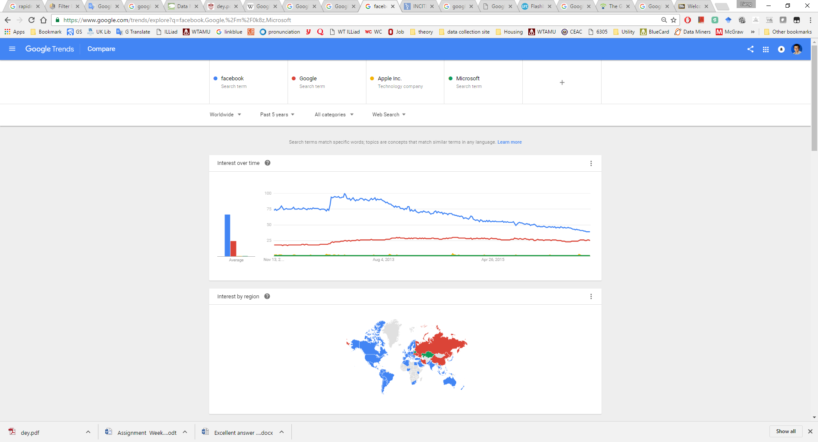
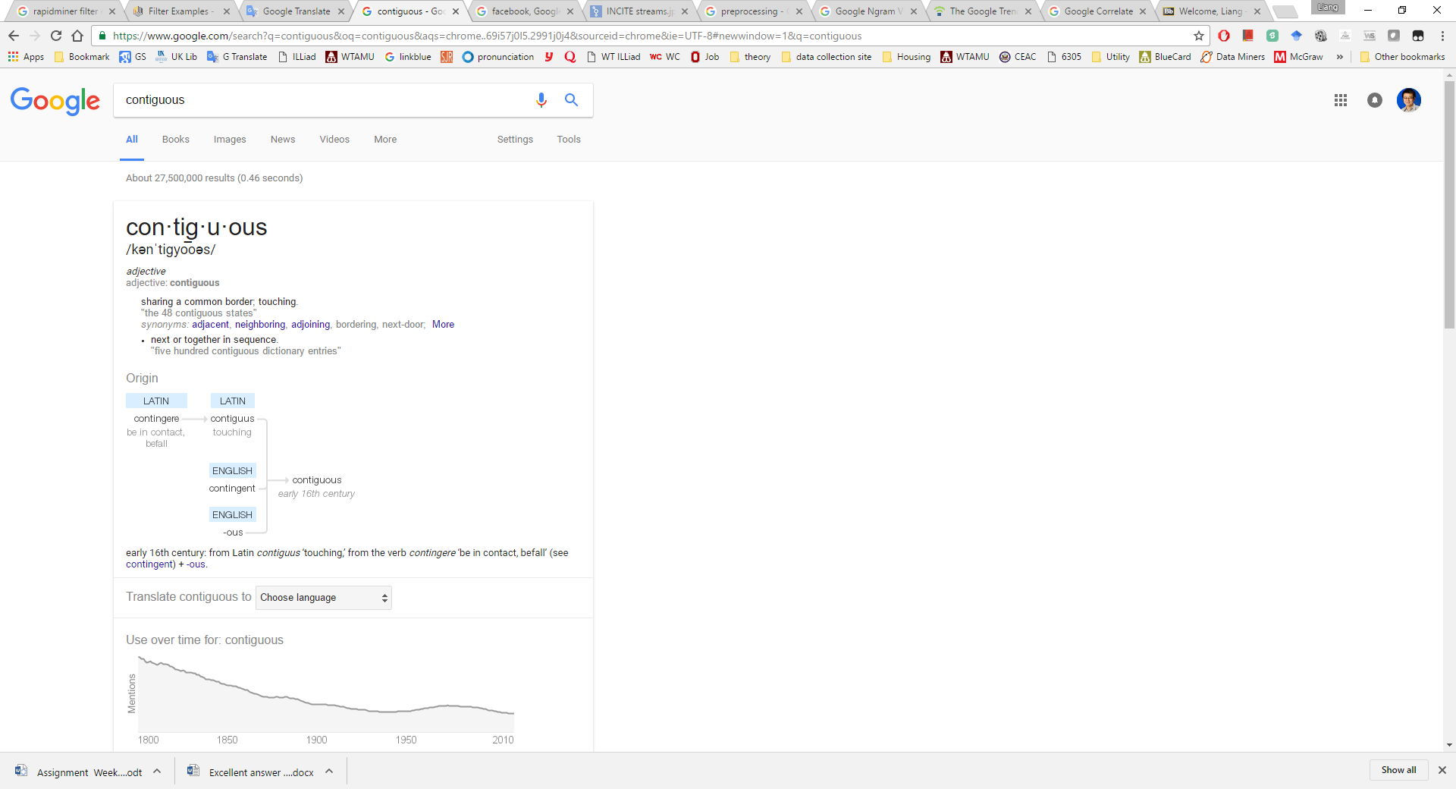
Text/Web Mining on Google

Slide 10
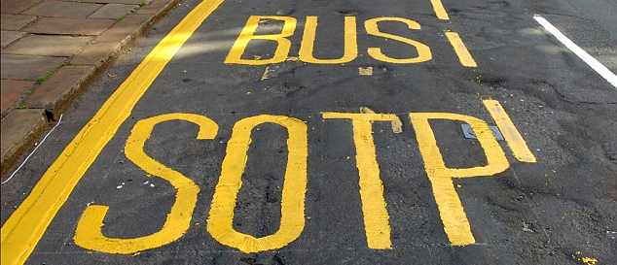
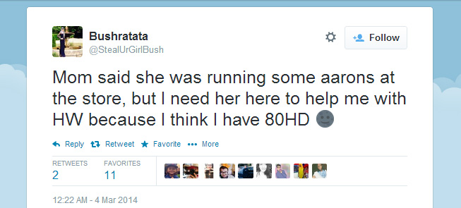
Challenges
Information is in unstructured textual form
Large textual database (see the next slide)
Very high number of possible “dimensions” (but sparse):
all possible word and phrase types in the language could be the columns
Complex and subtle relationships between concepts in text
“AOL merges with Time-Warner” “Time-Warner is bought by AOL”
Word ambiguity and context sensitivity
automobile = car = vehicle = Toyota
Apple (the company) or apple (the fruit)
Noisy data
Example: Spelling mistakes, tweets
Notes:
In In text mining, we only have documents. How can we transform those documents into a table format.
In data mining so far, our dataset is pretty small: a few thousands rows and less than 100 columns; in text mining, the database could be very large. The next slide will show you the data size of Amazon customer reviews from 1995 to 2013.
In text mining, all possible word and phrase types in the language could be the columns; thus, the data in the text mining may have thousands of columns /dimensions. However, those columns are generally sparse because people might use totally different words in various documents.
Complex and subtle relationships between concepts exist in text mining. For example, “AOL merges with Time-Warner” and “Time-Warner is bought by AOL” have the same meaning.
The fifth challenge is word ambiguity and context sensitivity. Different words can be used to describe the same thing. For example, some people may use car, vehicle to represent Toyota. The meaning of the same word is very specific to the context. For instance, apple could be a company or fruit. If you see the word “apple” in a technology news or forum, it probably refers to the company. If you see the word “apple” in a recipe, it probably refers to a fruit. How about this sentence: an Apple employee is eating an apple while writing codes in his office?
Another challenge is noisy data. For example, people tend to misspell or use abbreviation. This is very common on the internet-based texts such as comments, online reviews, and tweets. This brings a big challenge to text mining. We have to address this issue before we run text mining. I will give you one example on Slide 12.

Slide 11
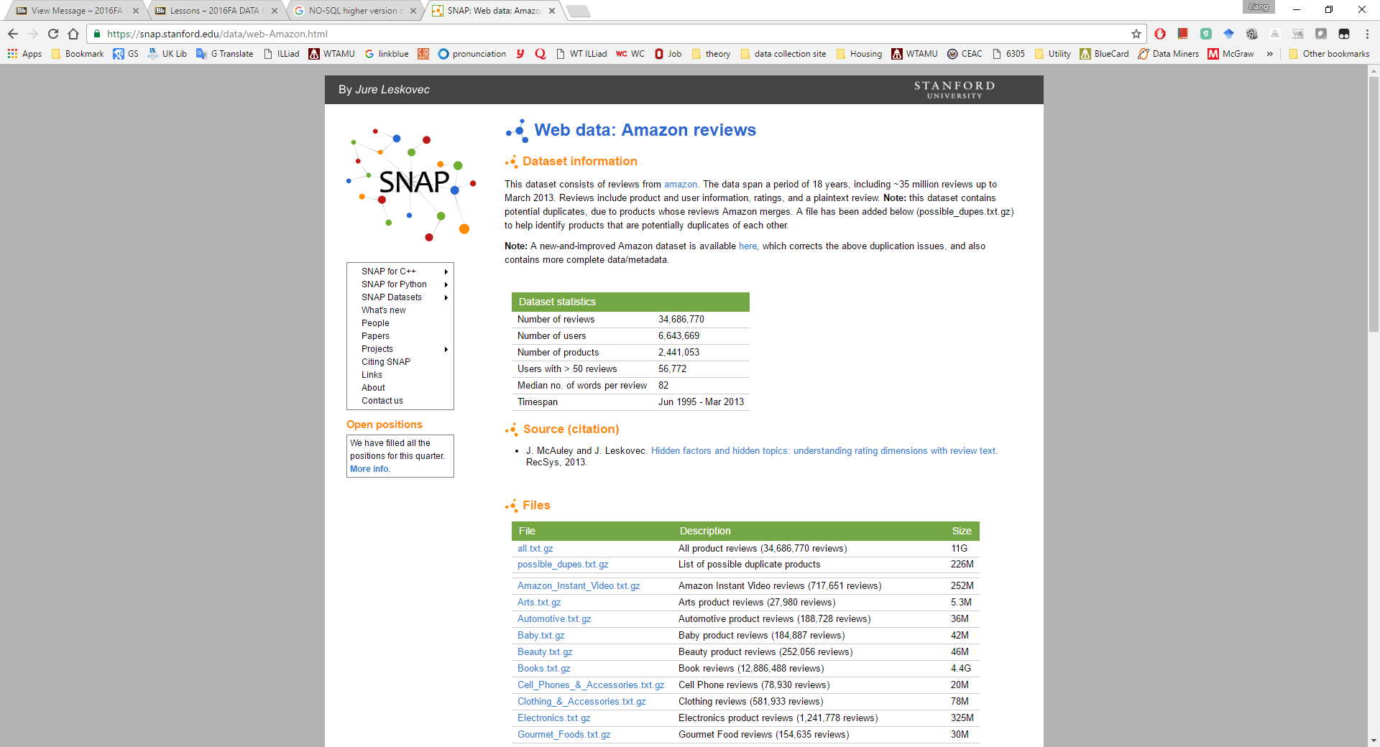
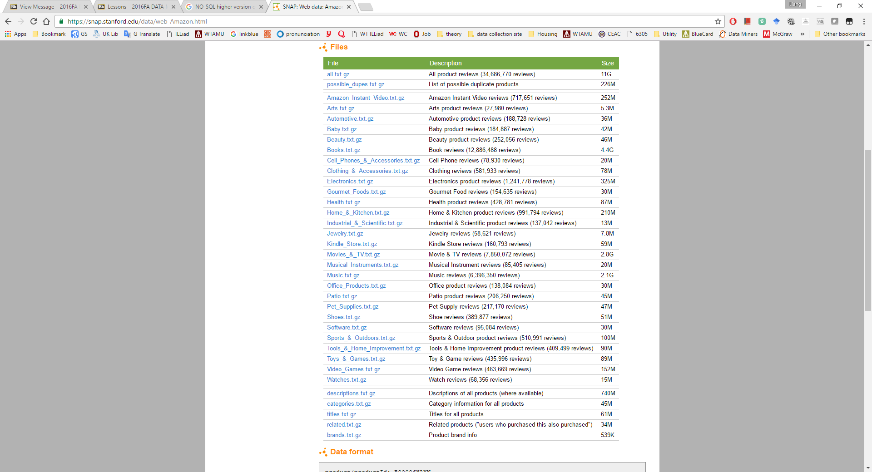
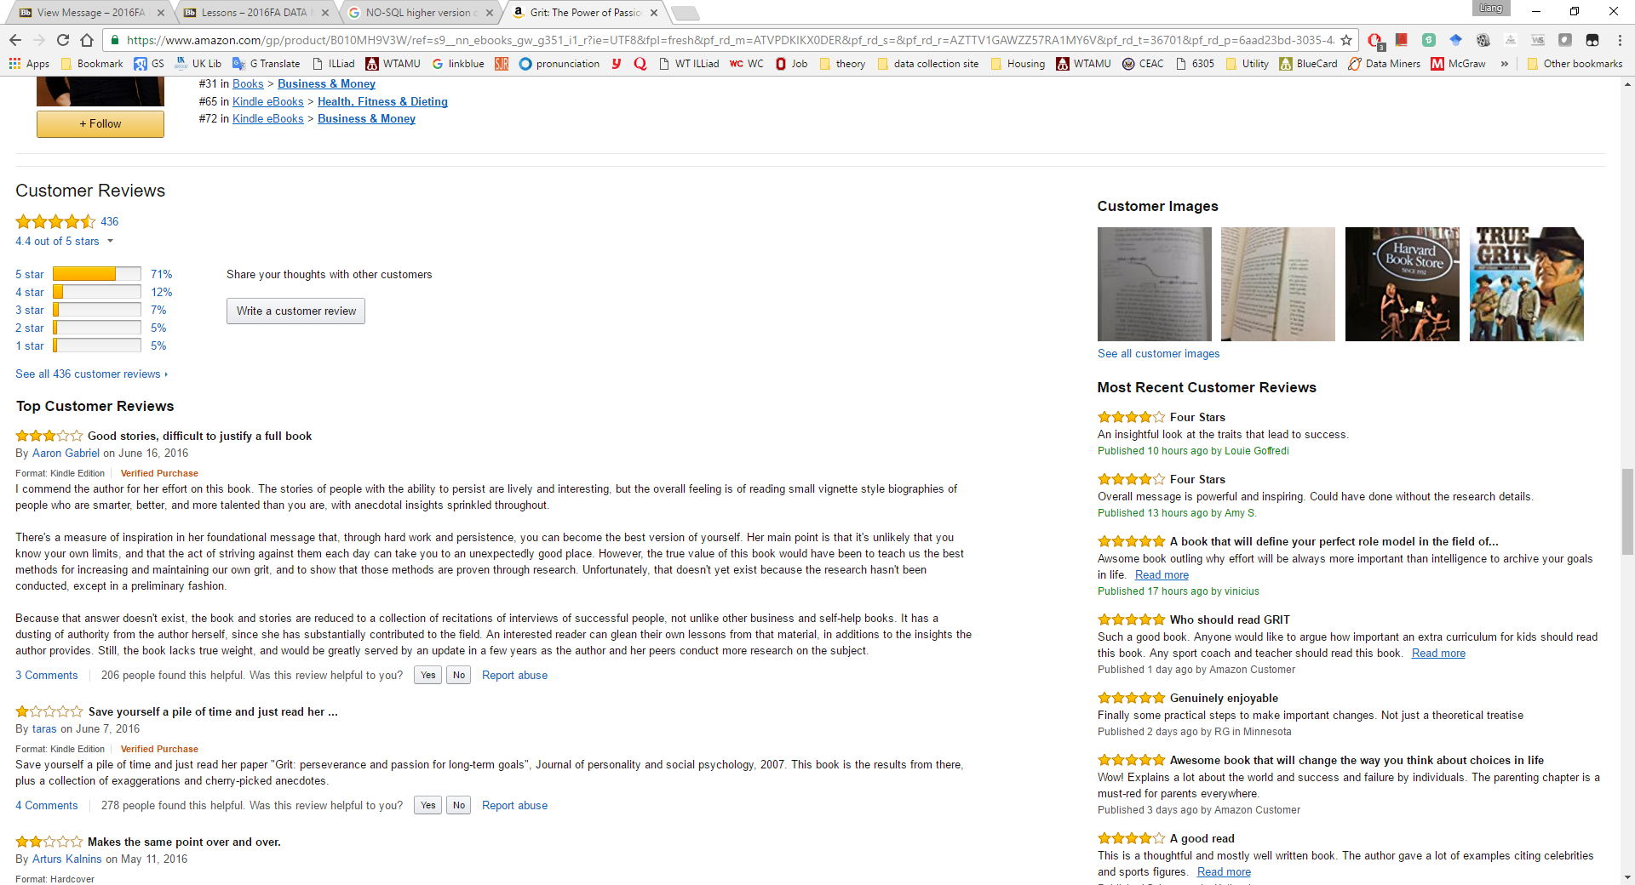
Large textual database for Amazon Review

Slide 12
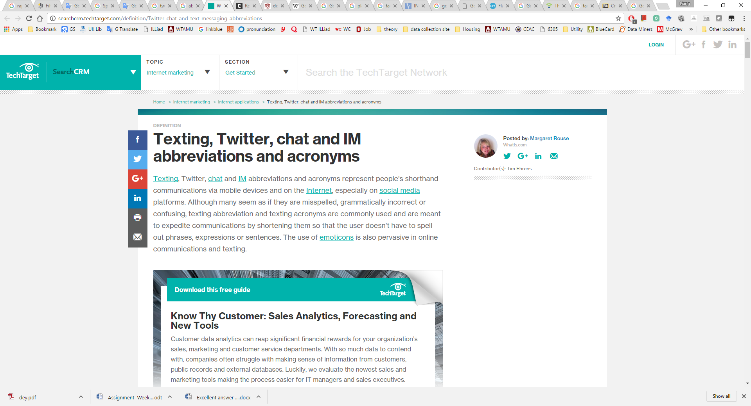
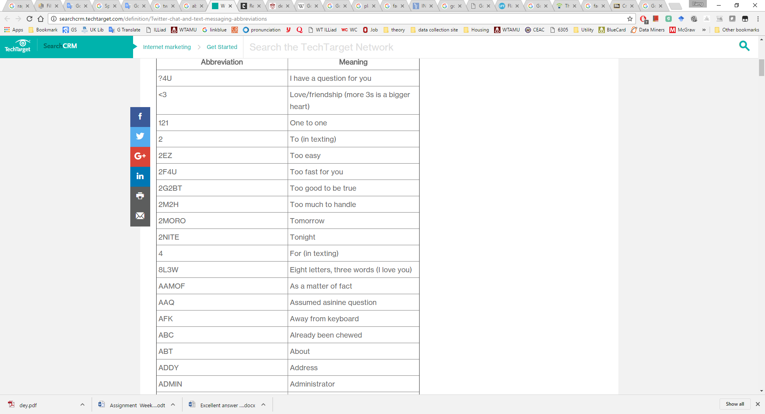
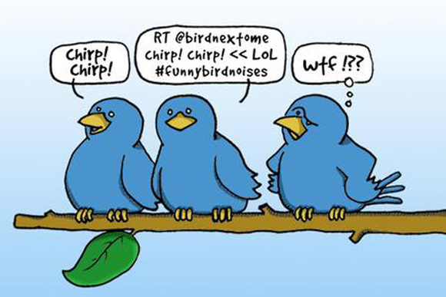
Noisy data
Context sensitive

Slide 13
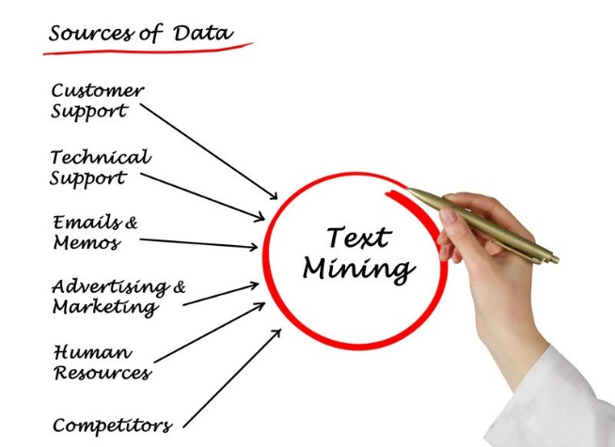
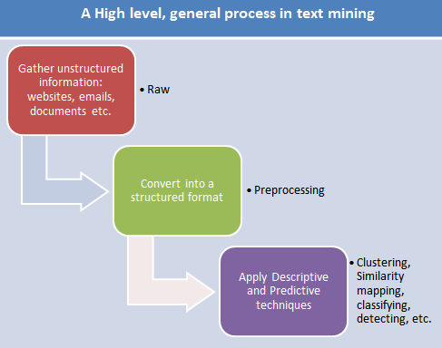
Text Mining Process
Data Collection
Many sources: e.g., Web crawler, open dataset
Data Preprosessing
Bag of words
Stem
Stop words
Word pairs (N-Gram)
Term-Document Matrix
Data mining
Classification (in our lab tutorial)
Clustering (in Matthew North’s book)
Association Rule
Analyze & Apply results
Notes:
Now, we are introducing text mining process. Basically, we first collect textual data, then preprocess them, and finally use data mining techniques we learnt in previous classes.
First of all, we need to gather unstructured data from various sources such as customer support, emails, memos, online reviews. In this step, we might use web crawler to obtain unstructured data.
In order to address the challenges we mentioned in previous slides, we need to preprocess the data we gather. The purpose of this step is to convert textual data to a structured format. This step includes many substeps such as bag of words, stem, and stop words. I’m going to introduce each of them in the next few slides.
After we get structured data, we can apply data mining techniques/algorithms we have learnt such as classification, clustering, and association rule.
Then, we can analyze and apply the results.

Slide 14
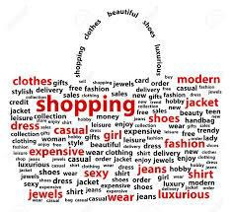
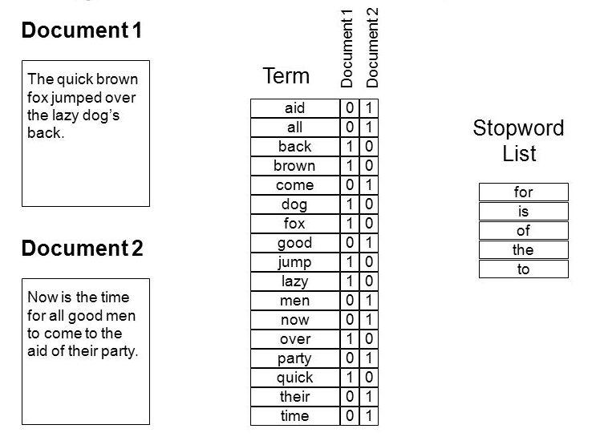
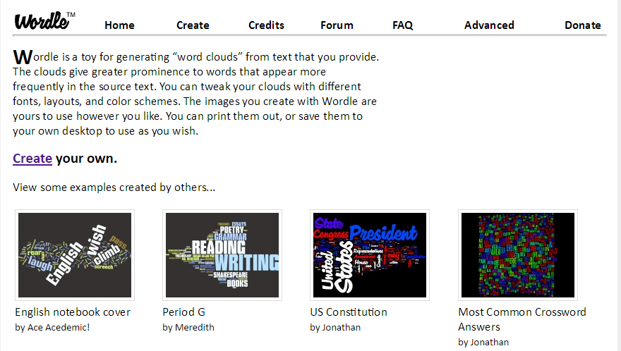
Bag of Words
The bag of words approach treats every document as a list of words.
This approach is an orderless document representation and disregards grammar and even word order but keeping multiplicity
In bag of words, “fish eats man” = “Man eats fish”
Used in document classification: the (frequency of) occurrence of each word is used as a feature for training a classifier.
Works well for long documents such as news, blogs or reports.

Slide 15
Text Mining Concepts
Corpus: All text documents in your dataset
Stop word: words that have little meaning should
be removed
Example: the, and, a, an, of, that…
Stem: Different words share the same word stem and should be represented with its stem, instead of the actual word
Example: fish, fishing, fisher,…

Slide 16
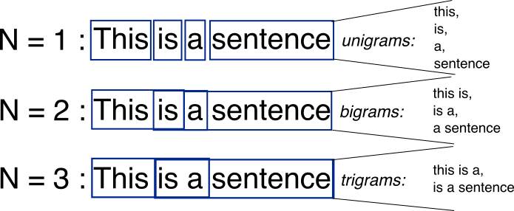
Word Pairs
Issues with single word approach
– Combination of multiple words may have a
different meaning: e.g.. “The Who”
n-gram is a contiguous sequence of n items from a given sequence of text or speech.

Slide 17
Term-Document Matrix
A simple array, where each row describes a document and each column represents a particular word.
Column:
Occurrence/Presence: True or false to describe whether or not a term appears in the document.
Term frequency (TF): Number of occurrences
Inverse document frequency (IDF):= 1/number of documents containing the term; words in many (few) docs have low (high) IDF values, describing the term importance
TF-IDF: Term frequency*Inverse document frequency; used to adjust for the fact that some words appear more frequently in general.

Slide 18
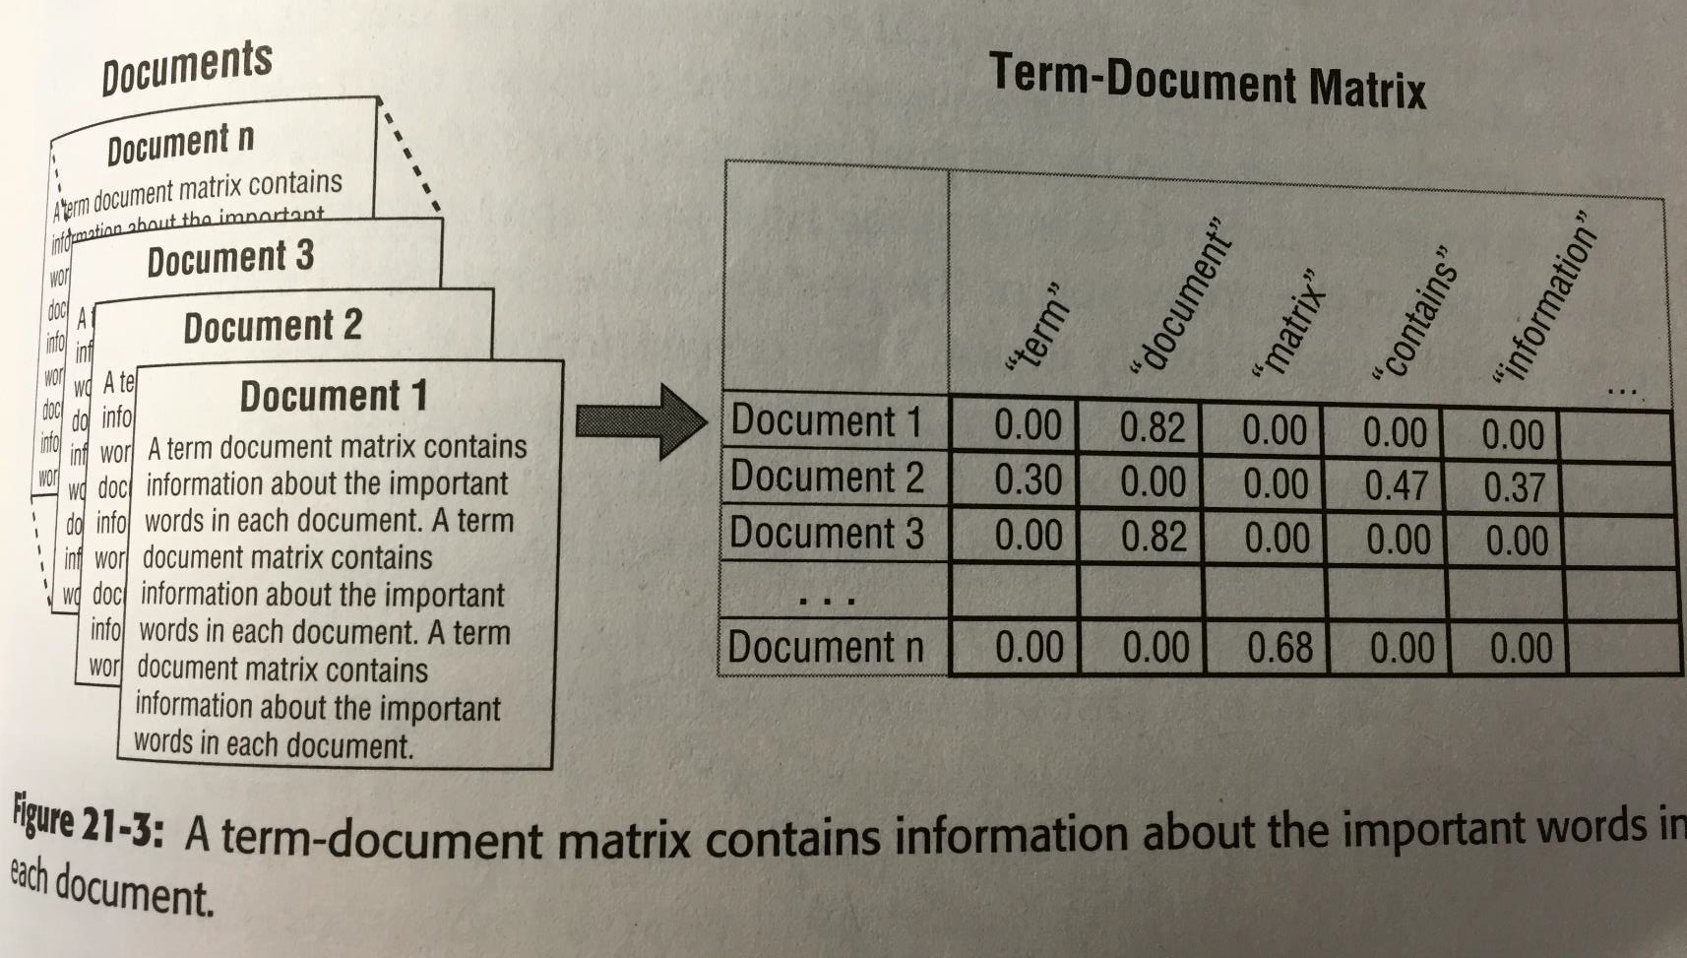
Term-Document Matrix
Linoff and Berry Book, Chapter 21, p.797.

Slide 19
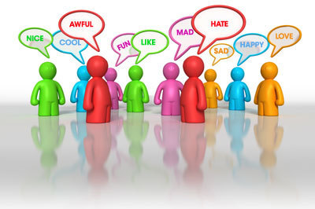
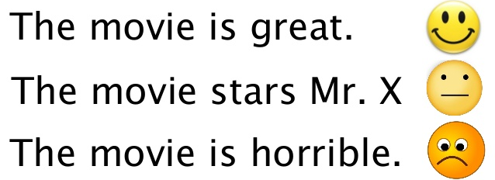
Sentiment Analysis
Automatically extract information about how people feel about something - a brand, a product, a stock…
Use of “Psycho-Social” Dictionary
Assign a sentiment label to each word
The sentiment of a sentence/document is based on the sentiment label of words.
Simplest approach: score=number of positive words-number of negative words.
Negative expression: not happy, not bad
Notes:
Sentiment Analysis is a special case of text mining.

